Slide 1
Introduction to Microsoft Word 2007
Um AL Qura University
Qadri Mishael

Slide 2
What is Word processing?
The creation, input, editing and formatting of documents and other text using software on a computer
What is Word processor?
A device similar to a simple computer, designed for word processing; Software that provides word processing functions on a computer, typically including typeface selection, line typically including typeface selection, line justification and other formatting, pagination, and numerous other features.

Slide 3
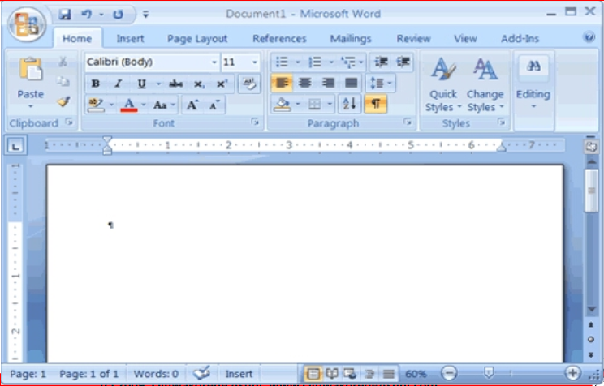
A Look on Word 2007

Slide 4
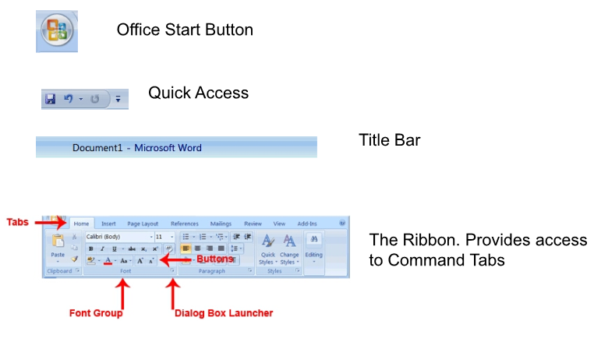
The Inteface

Slide 5
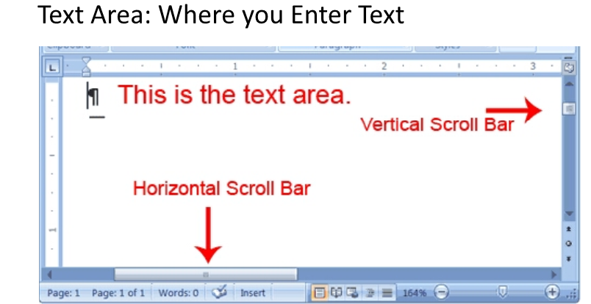

Slide 6
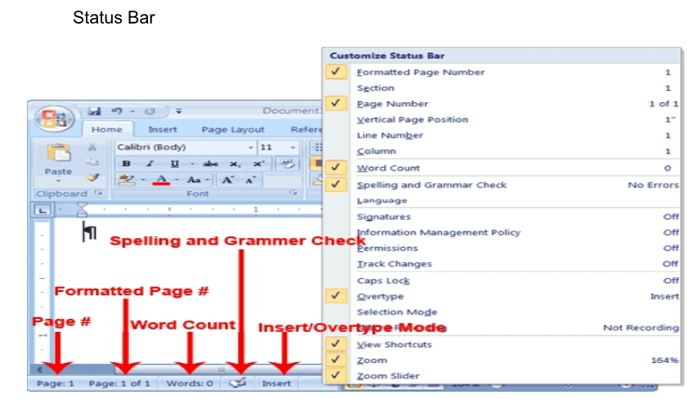

Slide 7
Starting your Word2007

Slide 8
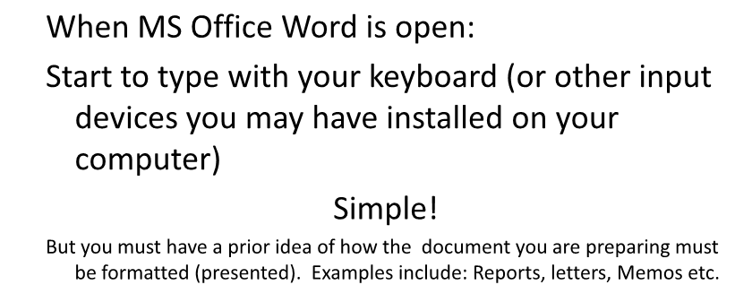
Entering Text

